Slide 1
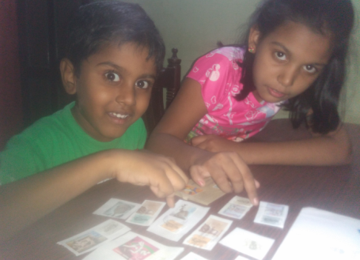
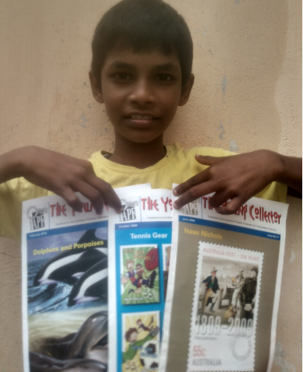
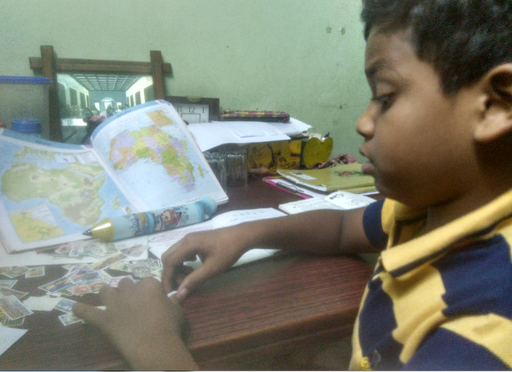

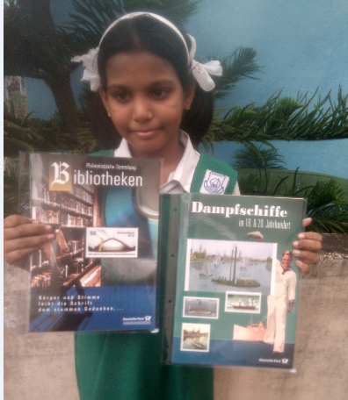
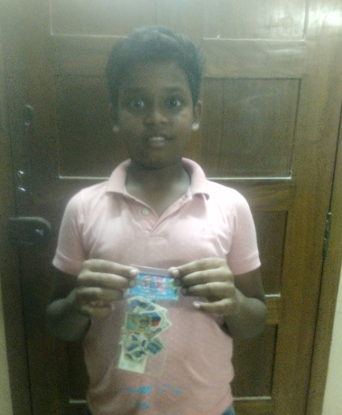
Heartfelt Thanks from the ‘Giving Back to Society’ initiative

Slide 2











Philanthropic Postal Agencies
Finland
Czech Republic
Spain
Australia
Portugal
Germany
Guernsey
Croatia
Iceland
Jersey
Malta
New Zealand

Slide 3








Philanthropic Postal Agencies…
Singapore
St Pierre et Miquelon
Polynesian Post
Philanthropic Philatelic Dealers and Associations
Belgium
CDD Stamps – Philippines
United Kingdom
Pittwater Philatelic Service - Australia
USA

Slide 4



Philanthropic Diplomatic Missions
Mr. Johannes Einarsson (honorary consul for Iceland in Monaco)
Mr. Laaksonen Heikki (honorary consul for Iceland in Finland)
Ms. Maria Dietmann - Norwegian Honorary Consulate in Salzburg, Austria
Mr. Christian Ulrik Syse - Royal Norwegian Embassy in Stockholm, Sweden
Ms. Michaela Calonius - Embassy of Sweden in Nicosia, Cyprus

